Slide 1
Condition Assessment of T&D Assets Using OSI PI
By Bill Cozzens
Presentation to the OSIsoft Utility Industry T&D Conference
Las Vegas, Nevada September 26, 2002

Slide 2
Condition Assessment Agenda
Overview of Condition Assessment (CA)
PI Architecture for CA
CA Components
Using CA Information
Implementing the Equipment CA Program
Wrap-Up & Questions

Slide 3
Condition Assessment Agenda
Overview of Condition Assessment (CA)
PI Architecture for CA
CA Components
Using CA Information
Implementing the Equipment CA Program
Wrap-Up & Questions

Slide 4
Business Challenges in T&D
Aging assets
Increased load
Expected reliability improvements -- PBR
Need for competitive edge -- return on capital
Departing expertise

Slide 5
Condition Assessment Business Drivers
Determination of asset health to focus maintenance and capital replacement activities
Provide an analysis platform for engineering activities
Perform condition-based maintenance
Reduce capital and maintenance costs to drive improved return on assets
Capital Replacement
Corrective Maintenance
Capital Replacement
Corrective Maintenance
Preventive Maintenance
Condition-Based Maintenance
Calendar-Based Maintenance
Before
After

Slide 6
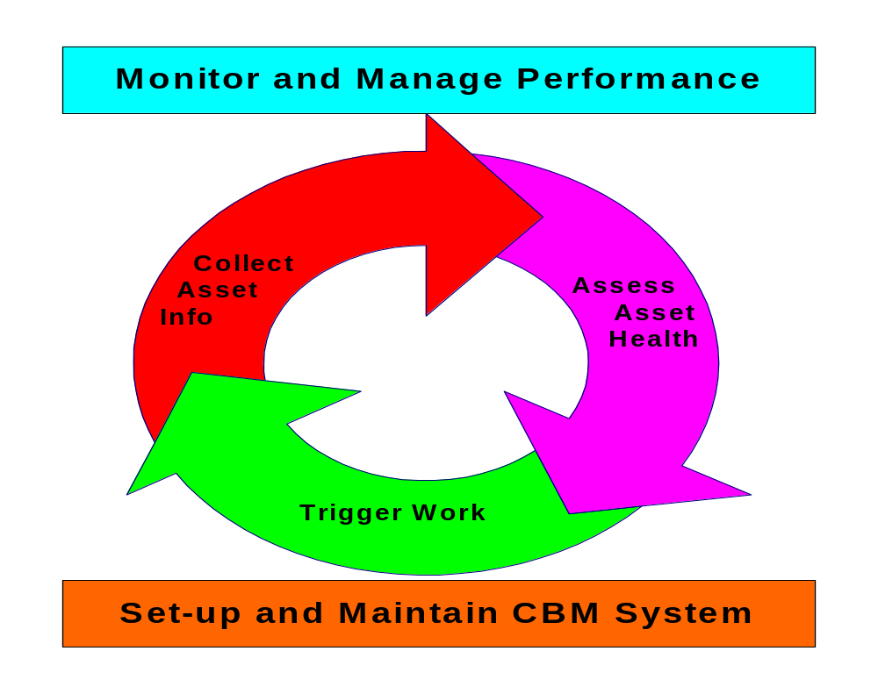
The CBM & Condition Assessment Life Cycle

Slide 7
Condition Assessment Agenda
Overview of Condition Assessment (CA)
PI Architecture for CA
CA Components
Using CA Information
Implementing the Equipment CA Program
Wrap-Up & Questions

Slide 8
Functional Requirements
Data Collection
Raw data
Analysis & Reporting
Feedback
Measurement Points
Maintenance Management
Notification
Work Order

Slide 9
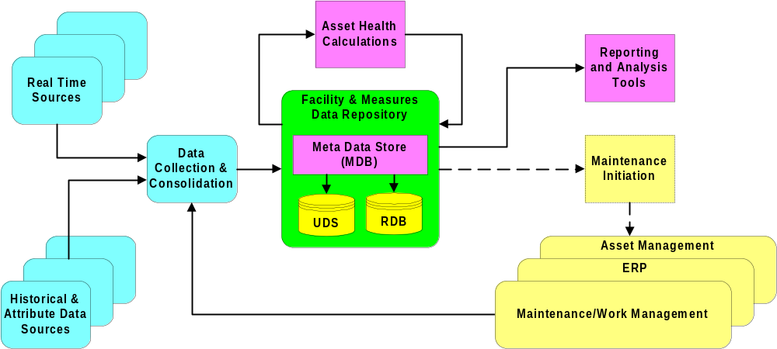
CA Conceptual Model
SCG’s approach to Condition Assessment uses the MDB as a central meta data repository for asset information and calculations.

Slide 10
Condition Assessment Agenda
Overview of Condition Assessment (CA)
PI Architecture for CA
CA Components
Using CA Information
Implementing the Equipment CA Program
Wrap-Up & Questions

Slide 11
Condition Assessment Components
Data Collection & Consolidation
Asset Health Calculations
Meta Data & the Facility & Measures Data Base

Slide 12
Data Collection & Consolidation
Philosophy: Consolidate in one place all available information useful for making asset “health” determinations
Real time & “trendable” data
  Sources: SCADA, transformer load data, DeltaX (transformer oil analysis), substation relay data, inspection results
  Storage: PI UDS
  Methods: PI to PI, PI Batch file interface, PI-API & PI Manual Logger
Attribute information (equipment changes, work, costs, diagnostics)
  Sources: ERP, MMS, Doble
  Storage: RDB
  Methods: Batch ETL, transactions

Slide 13
Asset Health Calculations : Condition
Condition Assessment (CA) = S₁(W₁) + S₂(W₂) + S₃(W₃) … + S_{n}(W_{n})
S = case score for each factor, values = 0 to 10
  0 = Best Condition 10 = Worst Condition
  Converting to an integer case value allows the combination of many quantitative and qualitative measures
W = weight in % for each factor, total = 100% Based on the relative importance of each factor
Condition Assessment is performed separately on different classes of equipment (breakers, relays, LTCs, transformers, etc.)
  Every class can have several or many subclasses. Each subclass can have its own factors and weights

Slide 14
Asset Health Factors Example
Factors for GCB >= 138KV subclass
  Historical maintenance cost
  Historical count of work orders
  Incorrect operations
  Gas addition quantity
  Compressor motor run-time
  Compressor crankcase oil -- added quantity
  Compressor crankcase oil -- added frequency
  Megger
  Ductor
  Timing

Slide 15
Asset health Calculations: Criticality
Criticality: Attempts to quantify the subjective measure of how important an asset is and/or the risk or loss that its failure would represent
Criticality = F₁(W₁) + F₂(W₂) + F₃(W₃) … + F_{n}(W_{n})
  Potential factors: replacement cost, age of asset, type of customers impacted, number of customers served, size, voltage, load
  Usually only estimated for most valuable and important classes of assets: eg. transformers, breakers, relays
  Simpler calculations: Subclasses usually not needed. Factors and weights can apply to all classes
  As with condition assessment, use case statements (values = 0 - 10) to combine diverse and qualitative measures

Slide 16
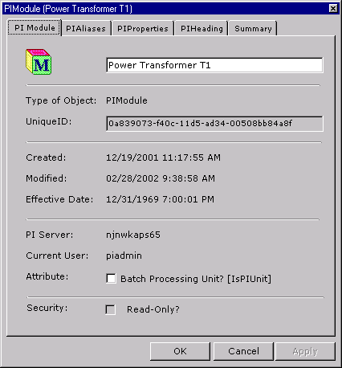
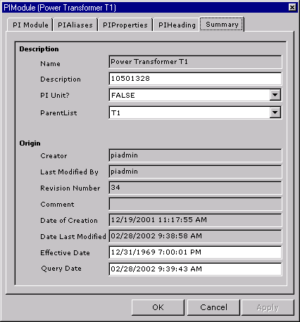
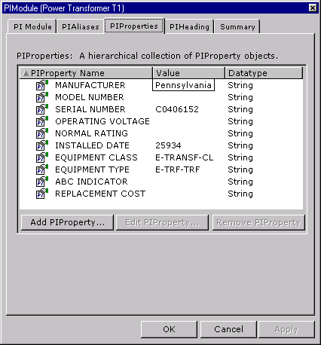
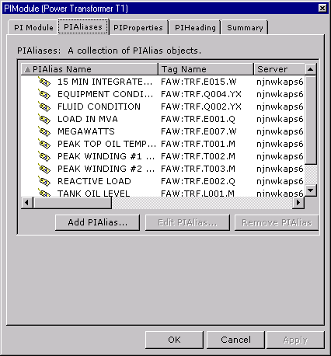
PI Module Database Overview
Define Module
  Descriptive Information
  Properties
  Tag Alias
Define Module Taxonomy
  Define Hierarchies
  Each level has a parent-child relationship
  Any module can appear many times in the hierarchy
  Load the hierarchies

Slide 17
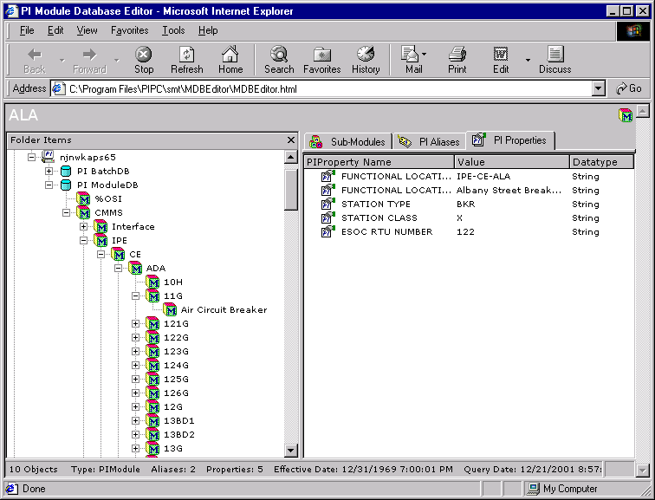
Utilizing PI MDB as the meta data store
MDB is the repository for asset information and condition assessment methods
  Equipment Hierarchies
  Asset descriptive information
  Equipment peer groups
  Storage of factor and weight definitions
  Look-up capability to retrieve the values needed to calculate factor values

Slide 18
Condition Assessment Agenda
Overview of Condition Assessment (CA)
PI Architecture for CA
CA Components
Using CA Information
Implementing the Equipment CA Program
Wrap-Up & Questions

Slide 19
CA Information Has Valuable Uses
Reporting and Analysis
  Capital Replacement or Maintenance Priority Lists
  Engineering & Maintenance Planning Analysis
Work Management Interface
  Triggering Alerts/Alarms, Maintenance Work Orders

Slide 20
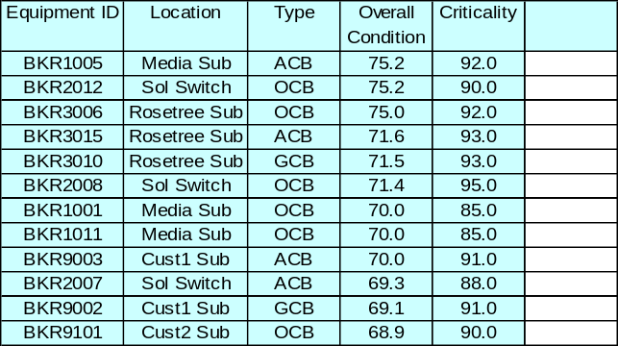
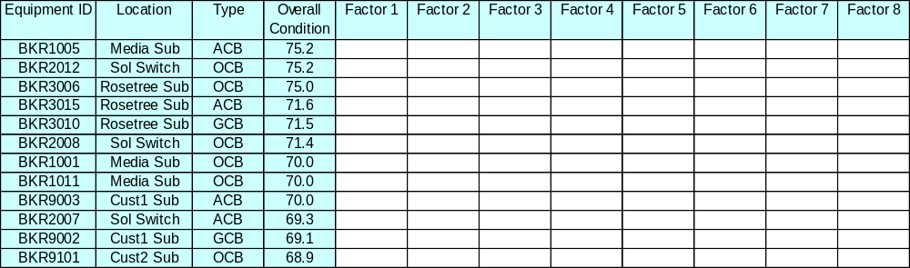
Capital Replacement or Maintenance Priority Lists
Finding the “Needle in the Haystack” -- prioritization of maintenance and capital replacement activities
Quickly being able to drill down to examine the contributory factors

Slide 21
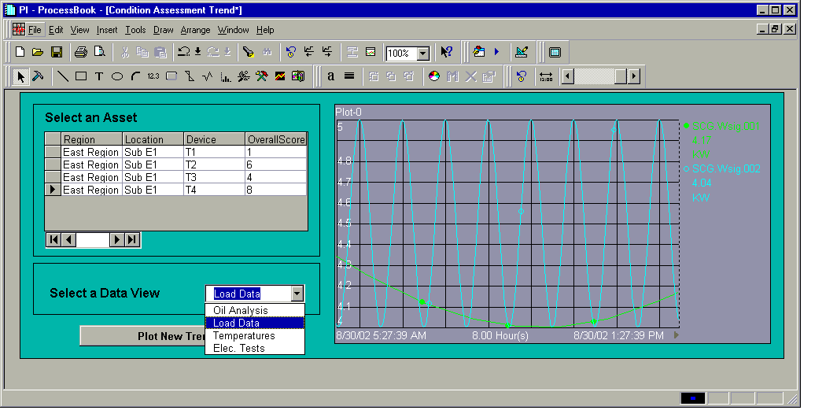
Engineering Analysis
PI graphical tools (Process Book, Active View, ICE) can be used to examine the underlying real-time data and distribute information across the organization.

Slide 22
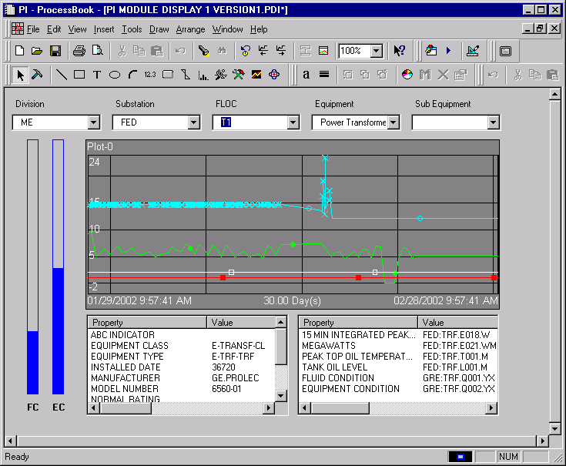
PI Module Database Driven Display

Slide 23
Work or Maintenance Management Interfaces
A link between Condition Assessment and Work Management can enable condition- or counter-based maintenance
Counter-based Preventive Maintenance. Suitable when PM criteria can be defined in terms of running time or number of operations
  Focus maintenance
  Reduce calendar-based PM costs
Generate notifications or alerts based on operating parameters exceeding specified limits.
  Reduce failures and trip outs
  Reduce corrective maintenance dollars

Slide 24
Work Management interface options
SAP Plant Maintenance (PM)
  OSIsoft offers the RLINK certified interface application
MRO - Maximo
  Version 5 programming interfaces expose Maximo data and methods for external systems
Indus PassPort
  Indus Connect Series with PassPort 9.0 enables connections to external digital systems
Digital Inspections - Cascade
  DI is currently building an interface to OSI PI

Slide 25
Interface Methodologies
Measurement Point (MP) Approach
  Within the WM app. measurement points are defined for each piece of equipment
  Measurement points can have upper and lower limits; each associated with a maintenance plan or procedure
  Data readings from PI set or increment the measurement point. When the MP level or counter hits or exceeds the limit work order or alert is issued
Alternative
  Define accumulator tags in PI for equipment of interest
  Establish limits, triggers and id maintenance procedures in MDB for that equipment
  When limit is exceeded, trigger work in WM application using API or RPC

Slide 26
SAP PM - RLINK Interface
RLINK
Service
Measurement Document
Alarms & Current Value
Tag references
PI - UDS
RLINK Configuration
Measurement Point
FLOC or Equipment
Maintenance Plan
RLINK Configuration
-Alarm tag for when to send MD
-Tag value for MP
-Generate Notification with MD
-Text, priority, type of Notification
Calendar Event
Notification
or Order

Slide 27
Condition Assessment Agenda
Overview of Condition Assessment (CA)
PI Architecture for CA
CA Components
Using CA Information
Implementing the Equipment CA Program
Wrap-Up & Questions

Slide 28
Issues in Implementing Equipment Condition Assessment
Project Considerations
Business Process, Organizational and Role Issues
Criticality of Data

Slide 29
CA Project Components
Project Strategy: CA should support your RCM and/or Condition Based Maintenance philosophy
Capturing and articulating T&D system & equipment engineering and maintenance expertise: identification and definition of the condition and criticality factors and weights
Data management effort (initial and on-going). Asset register. Establishing and correlating data sources with equipment. Data scrubbing.

Slide 30
CA Project Components
System architecture, design and integration.
Planning for information utilization
Modification or setting up new equipment maintenance and engineering business processes to feed, maintain and utilize the new information

Slide 31
Condition Assessment Agenda
Overview of Condition Assessment (CA)
PI Architecture for CA
CA Components
Using CA Information
Implementing the Equipment CA Program
Wrap-Up & Questions

Slide 32
Benefits of This Approach to CA
CA takes advantage of your existing information technology
CA is agnostic or at least ecumenical in terms of the various maintenance religious beliefs. Can support RCM, PMO, etc.
CA is flexible -- reporting, engineering analysis, triggering work management
CA minimizes your IT maintenance costs by being completely end-user configurable
CA involves a minimum number of products – reducing complexity and interface requirements

Slide 33
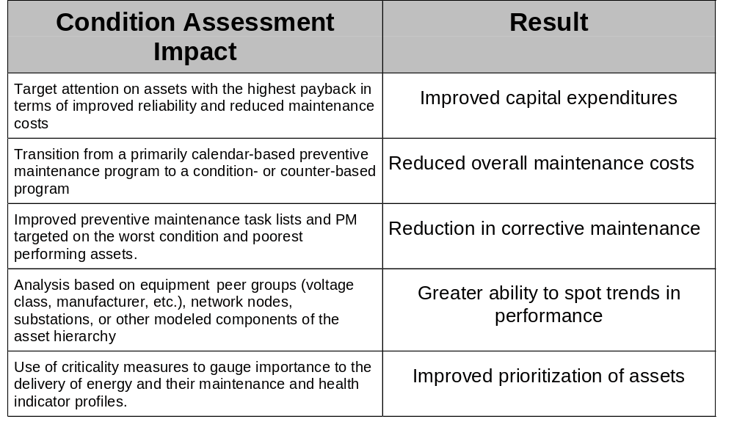
CA Impacts and Results

Slide 34
Keep Your Eye on the Big Picture
AS IS
Capital Replacement
TO BE
Capital Replacement
Corrective Maintenance
Corrective Maintenance
Preventive (Calendar-Based) Maintenance
Condition-Based Maintenance
Calendar-Based Maintenance

Slide 35
Questions & Discussion
Automating Processes. Managing Information.
Driving Business.

